Slide 1

Group – 8 Pooja Peechara – 11663837 Rachana Reddy Sunki – 11709719 Mounika Nuchu – 11653658 Lagadapati Kondarao – 11661743 Yenugu Ruthiksha Reddy - 11714976
Ransomeware Research & Mitigation

Slide 2
Introduction
Research
Project Plan
Get Set Go!
The research explores the development and mitigation of ransomware using advanced encryption and machine learning, aimed at enhancing cybersecurity strategies.
Our plan is designed to explore the development of a simulated ransomware within a virtual environment, covering everything from building the ransomware to deploying, detecting, and
mitigating it effectively.
Let’s look at the later slides on how we implemented each phase of the project.

Slide 3
Literature Review: Ransomware - Threats and Defenses
The Evolution of Ransomware: Modern ransomware has evolved significantly, using advanced techniques such as obfuscation and offline capabilities to target both individuals and large corporations.
Categorization and Methods: Ransomware attacks have been categorized into a taxonomy that helps in understanding their various delivery, propagation, and execution methods. This categorization is useful for developing defenses and mitigation strategies.
Advancements in Detection Techniques: The field has seen significant advancements in ransomware detection, notably through the use of machine learning. These techniques are becoming essential tools for cybersecurity professionals to identify and respond to threats swiftly.
Comprehensive Defensive Frameworks: The Detection Avoidance Mitigation (DAM) framework proposes a unified strategy to classify, detect, and mitigate ransomware attacks, providing a structured approach to combat this growing threat.
Challenges and Future Directions: Despite progress, there are ongoing challenges in effectively detecting and countering ransomware. The field is ripe for further research, particularly in areas like real-time detection and the development of more adaptive security measures

Slide 4
AES Encryption and Cryptography.Fernet
Choosing AES: Advanced Encryption Standard (AES) was chosen due to its balance of security and efficiency. AES is widely recognized for its robustness and is used globally for secure data encryption, making it an ideal choice for protecting sensitive information.
Using Cryptography.Fernet: The Cryptography.Fernet module in Python provides high-level cryptographic capabilities that are easy to implement and use. It handles all aspects of key generation, encryption, and decryption, offering a secure and developer-friendly interface for encryption tasks.
Implementation Challenges: Key management posed a significant challenge, necessitating careful handling to ensure security and prevent unauthorized access. Performance optimization was also a crucial focus to ensure that encryption processes did not overly degrade system performance.

Slide 5
Ethical Considerations
Responsible Research Practices: The project was guided by strict ethical standards, focusing solely on educational purposes and ensuring that no real systems were harmed. This involved rigorous testing within controlled environments to prevent any unintended consequences.
Isolated Testing Environment: All testing was conducted within a virtual machine specifically set up to contain the ransomware safely. This isolation prevented any potential leakage or accidental damage to actual operating systems or data.
Preventing Misuse: Measures were put in place to restrict access to the developed ransomware, ensuring that it could not be used maliciously. The project also focused on defensive measures rather than offensive capabilities, aligning with ethical research guidelines.

Slide 6
Action!
Action is the first phase where we implemented encryption to the folder Critical as the target directory.
AES protocol and Cryptography.Fernet packages are used for Encryption and Decryption
Getting hands dirty by testing this prototype within local machine, using python commands.

Slide 7
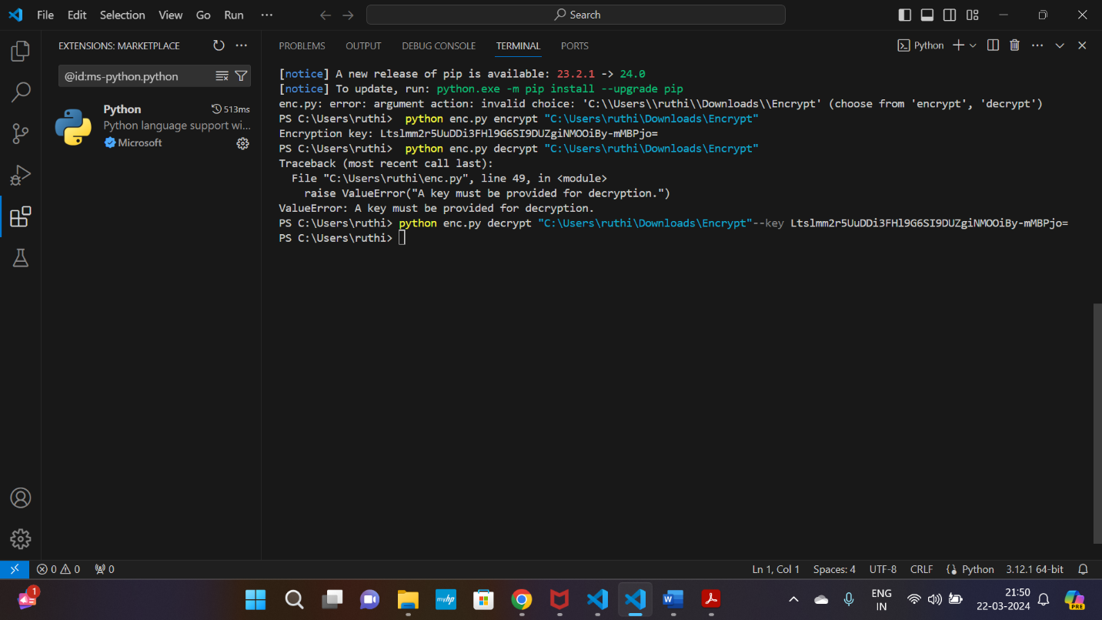
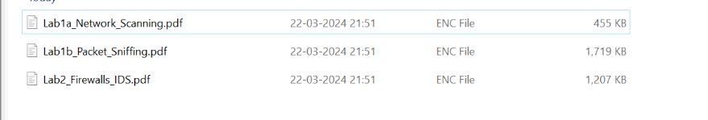
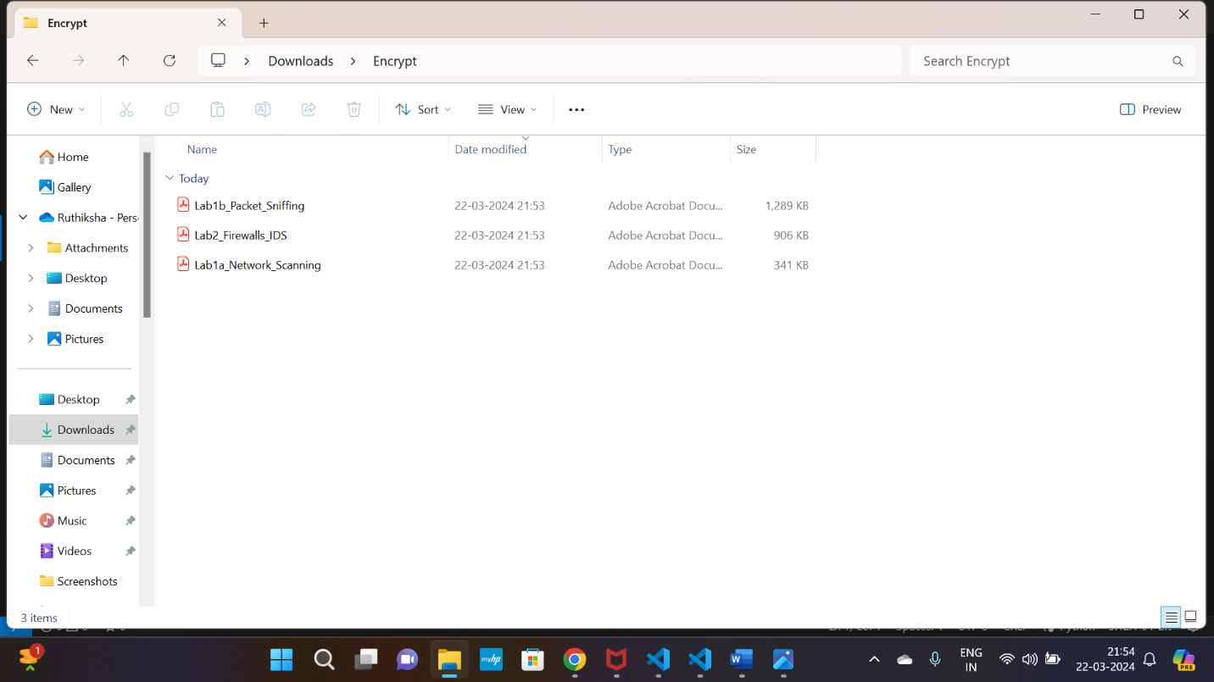
Commands
Python Ency.py encrypt C://users//ruthi//critical –-Key (hex key)
Result:
Original files are encrypted using the encrypt function, later the key generated is used to decrypt and get back the original files.
Encrypt: Decrypt:

Slide 8
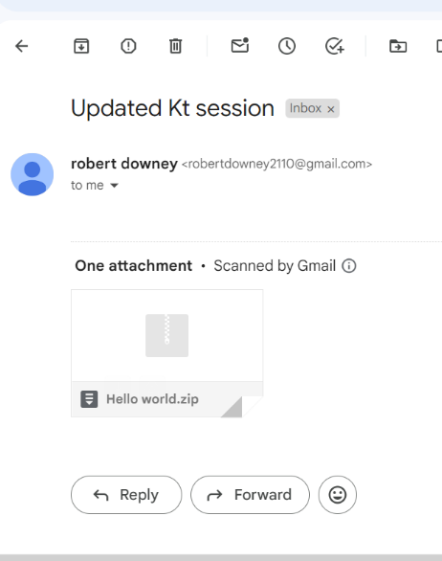
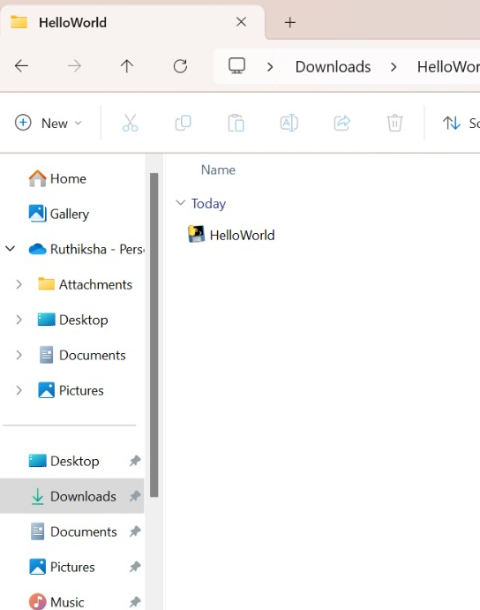
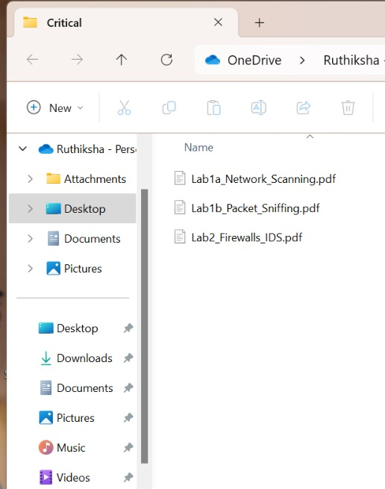
Infection
This is my favorite part of the project, where a prototype of executable malware is designed and users are lured into running it by using a spam email.
The malware, when injected into an executable file, encrypts the entire library upon execution.
The hacker will need to decrypt the files using the secret key, which will be provided once the ransom is paid
1.Email 2.Injection 3.Infection(encryption)

Slide 9
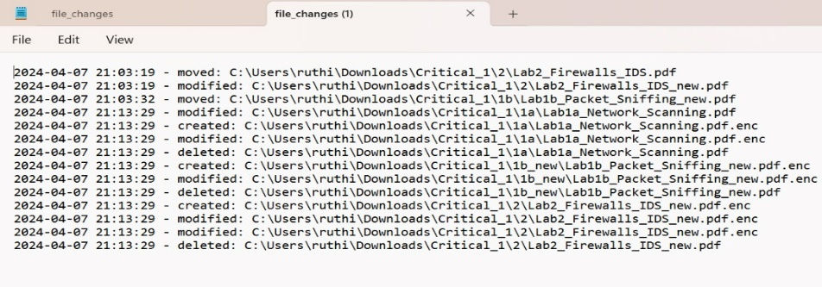
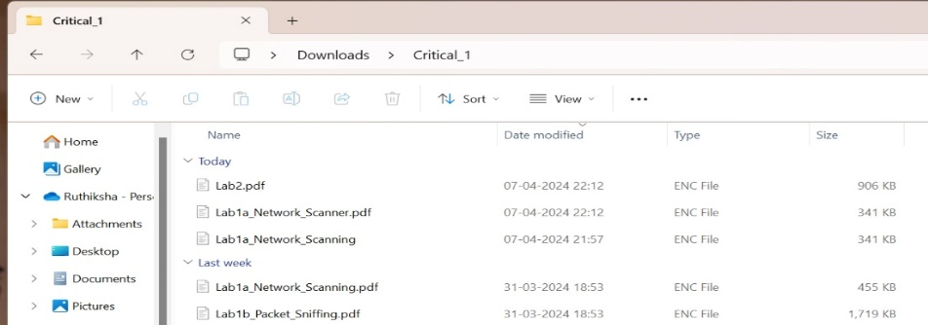
Monitoring
From this phase we are protecting the Critical Directory, watch-dogs module is used to monitor and maintain logs
To test the monitoring algorithm, previously prototyped encryption algorithm is utilized and checked if the logs record the activities

Slide 10
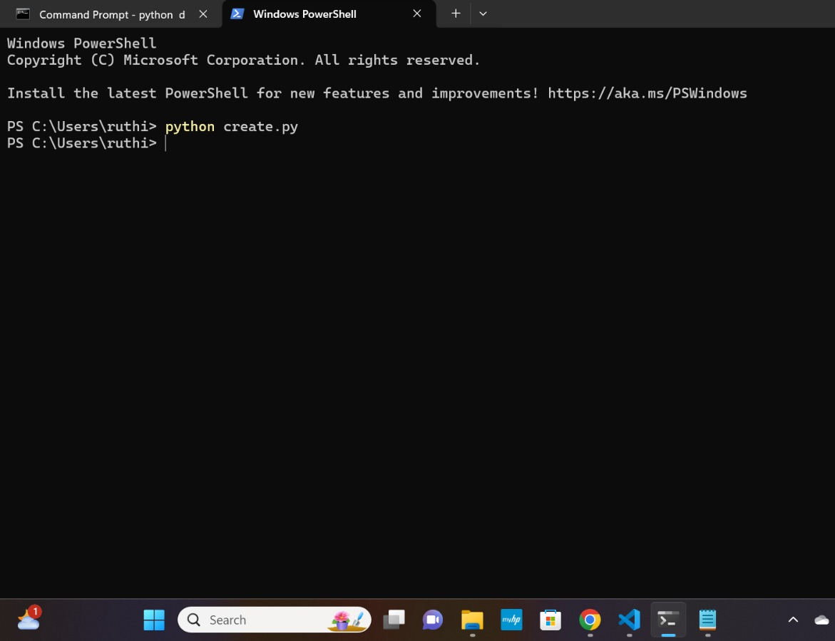
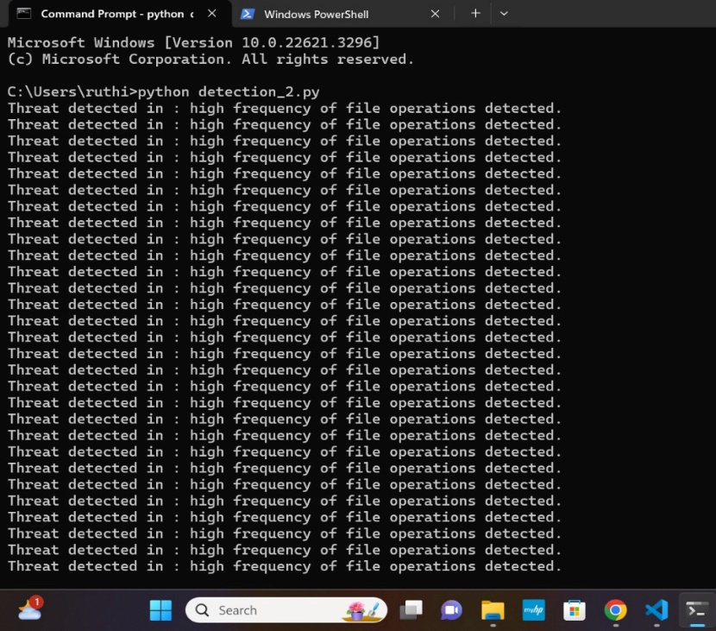
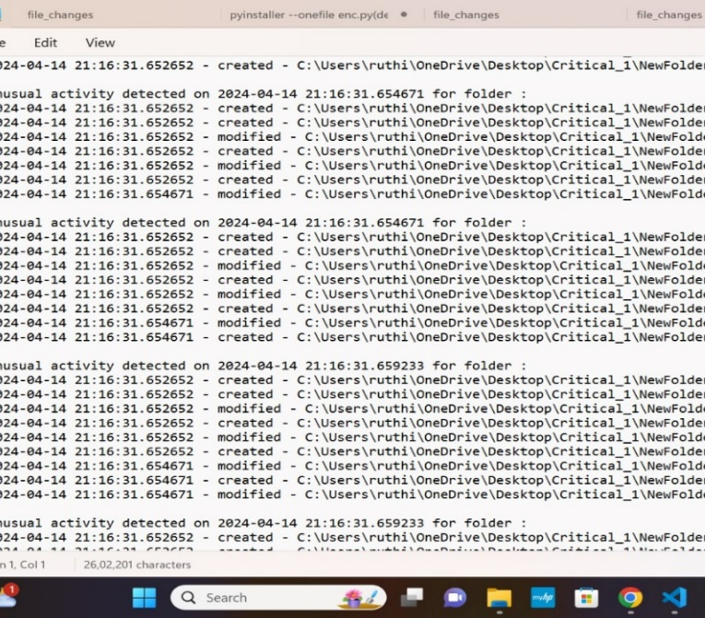
Detection
Previous phase we are tracking the activities of critical folder
In this phase we are utilizing this log activity to detect the unusual activities
We simulated this using create.py which creates/dumps files in high volume.

Slide 11
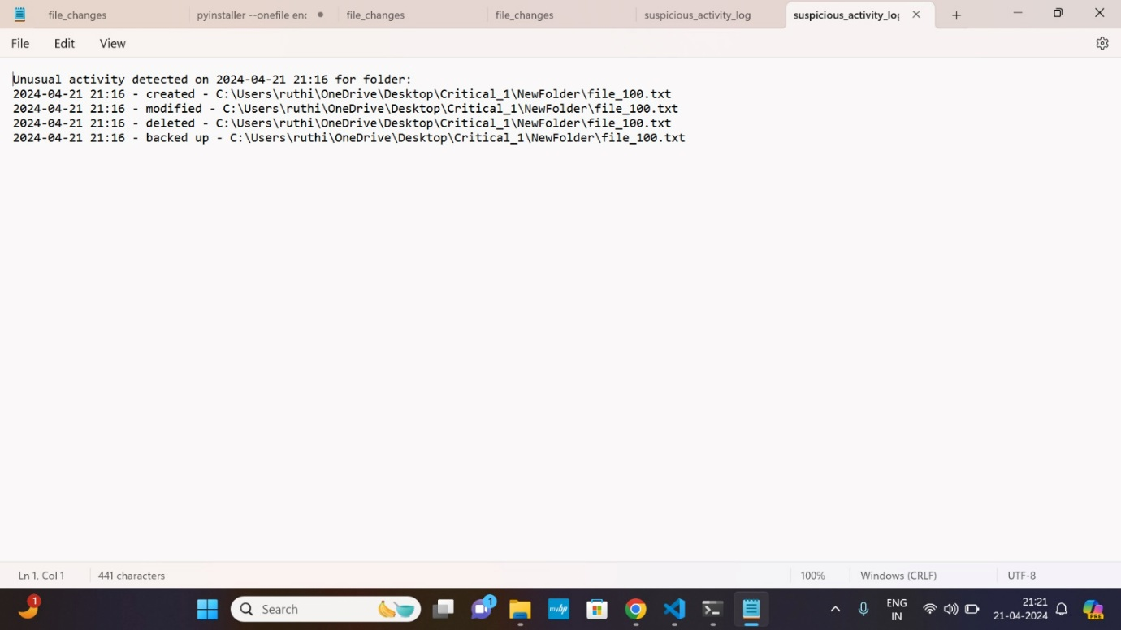
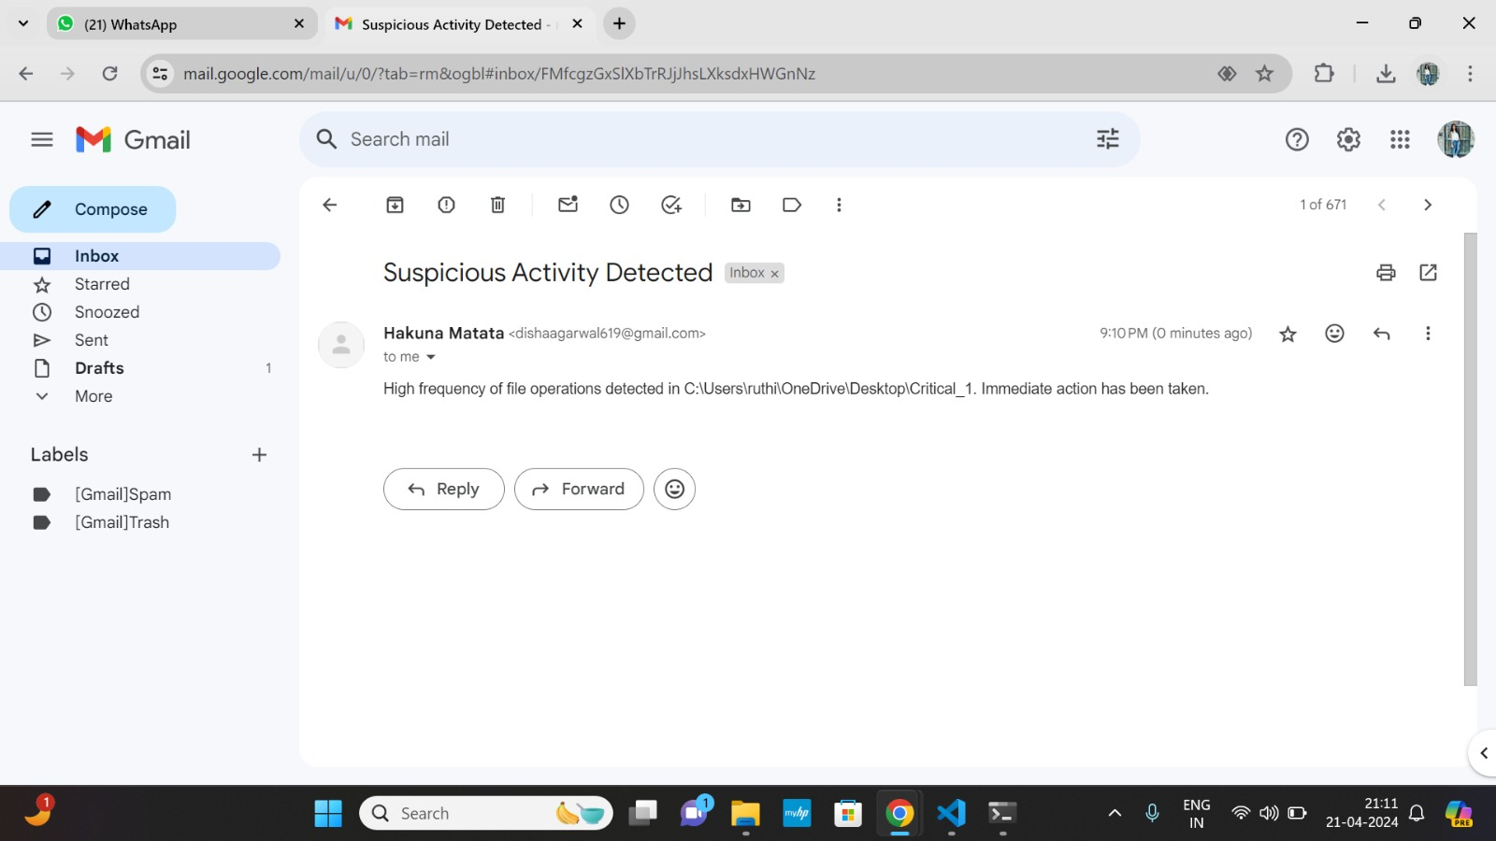
Mitigation
In this stage we are implementing a backup service where an unusual activity restricts the access to the folder after backing up with the original files
An email alert is also sent providing the details of the attack.

Slide 12
conclusion
In wrapping up, our project not only showed us the technical ropes of ransomware but also gave us a real feel for its dangers. Simulating an attack was as thrilling as it was a serious lesson in why solid cybersecurity is non-negotiable. It's been a heck of a journey from crafting malicious code to seeing the real impact it could have.

Slide 13
References
[1] R. Gupta, S. Tanwar, G. Sharma, and I. E. Davidson, "Ransomware Detection, Avoidance, and Mitigation Scheme: A Review and Future Directions," Sustainability, vol. 14, no. 1, 8, Dec. 2021. [Online]. Available: https://doi.org/10.3390/su14010008
[2] Author(s), "Title of the Article," Journal Name, vol. #, no. #, pp. page range, month year. [Online].
[3] Author(s), "Enhancing Ransomware Attack Detection Using Transfer Learning and Deep Learning Ensemble Models on Cloud-Encrypted Data," Electronics, vol. 12, no. 18, 3899, Sept. 2023. [Online]. Available: https://doi.org/10.3390/electronics12183899

